Slide 1
Meme Review:
Dead or Alive?
Phase 2
Predicting Reader Response to Timely Memes using Machine Learning

Slide 2

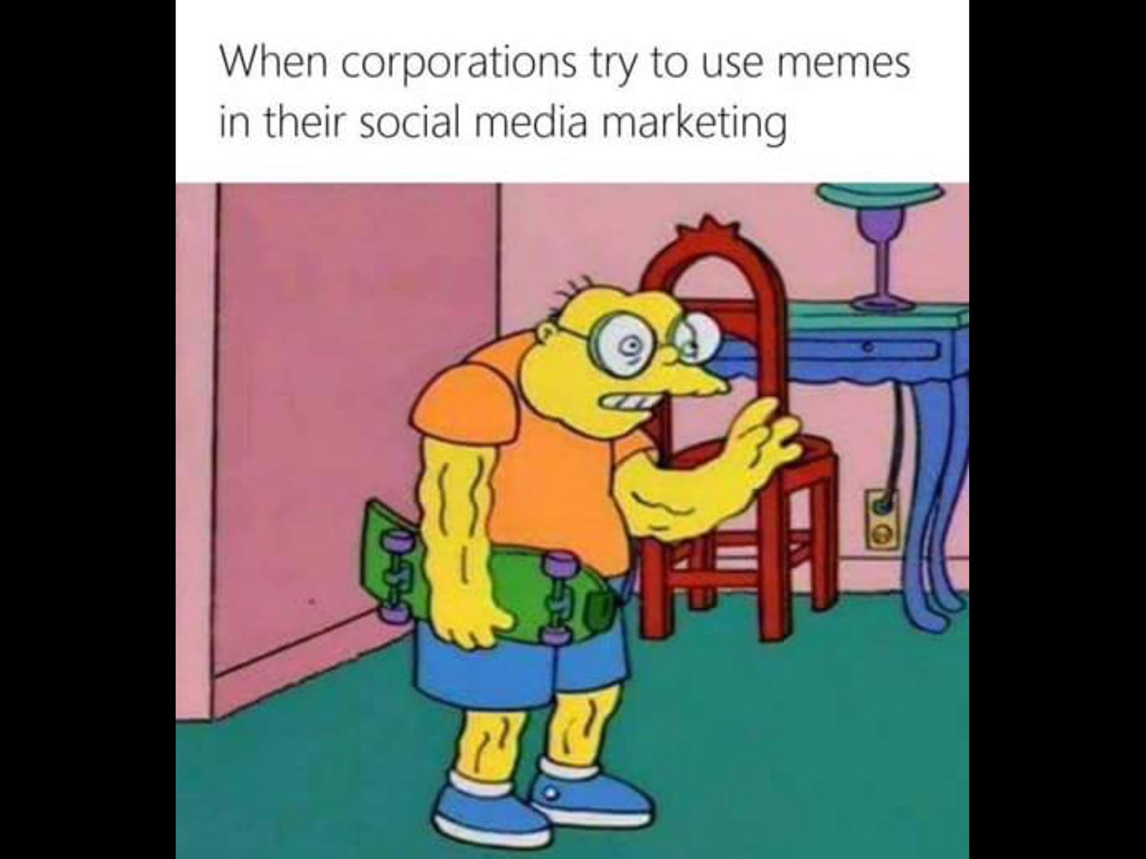
Motivation & Problem Definition Recap
2 out 5 Facebook posts are memes
Memes are a great marketing tool
Millennials LOVE memes
Online Businesses and Influencers
Massive Data dump

Slide 3
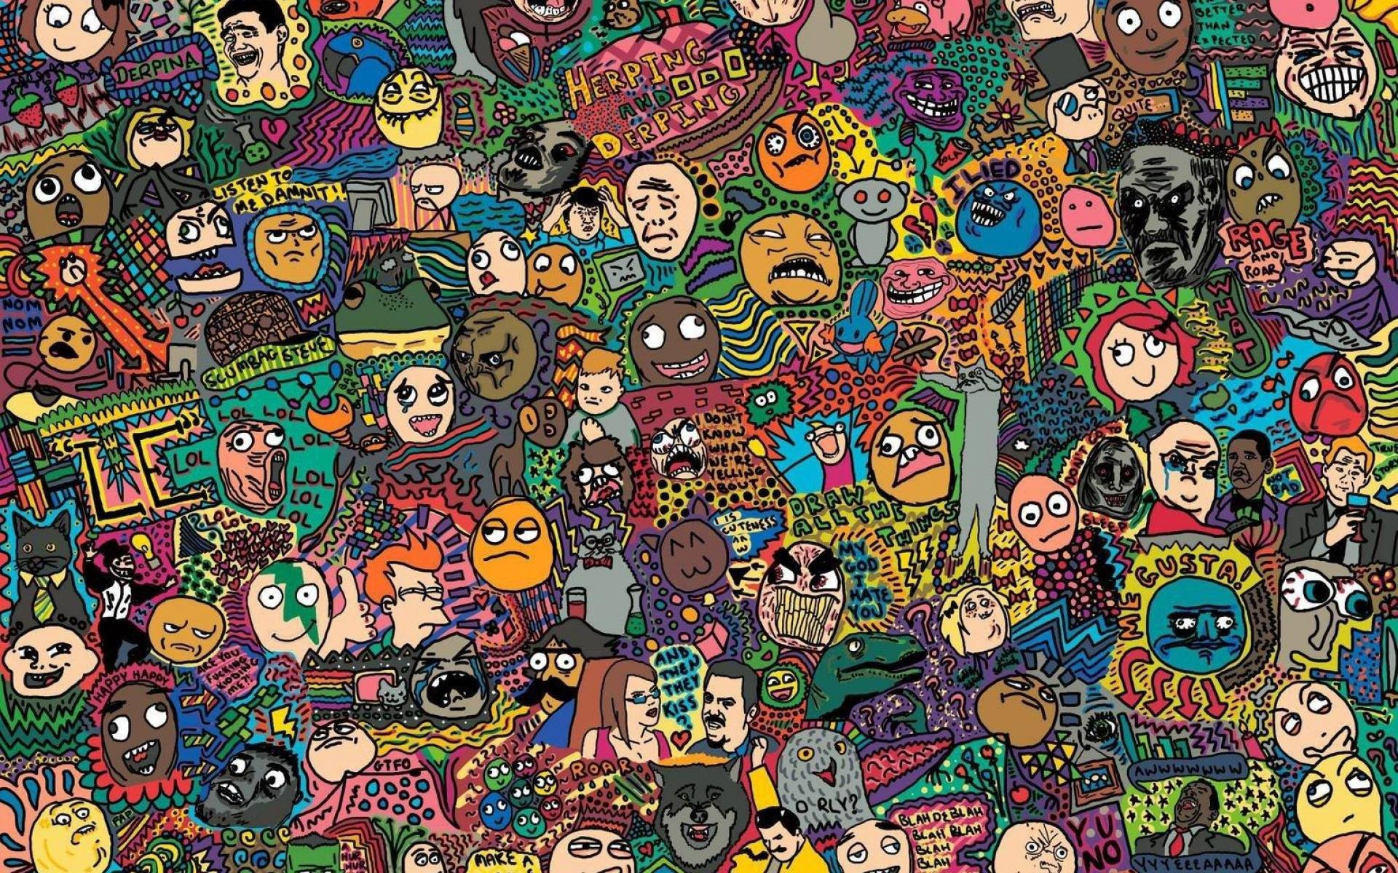
Background
What we set out to learn
How the internet affects many variants of people
How internet memes gained and maintained popularity
How images are shared in internet media
How to automatically find classifiable features
How to cluster similar looking images

Slide 4
“Insights into Internet Memes”
It is commonly assumed that Internet memes spread virally but scientific evidence as to this assumption is scarce.
Investigate the epidemic dynamics of 150 famous Internet memes.
The analysis is based on time series data that were collected from Google Insights, Delicious, Digg, and StumbleUpon.

Slide 5
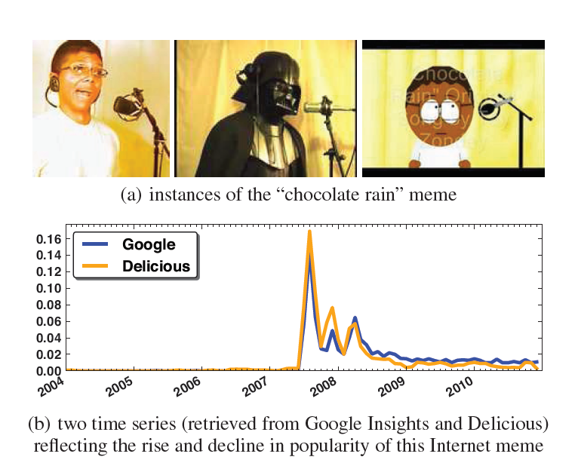
Differential equation models from mathematical epidemiology + simple log-normal distributions = a good account of the growth and decline of memes.

Slide 6
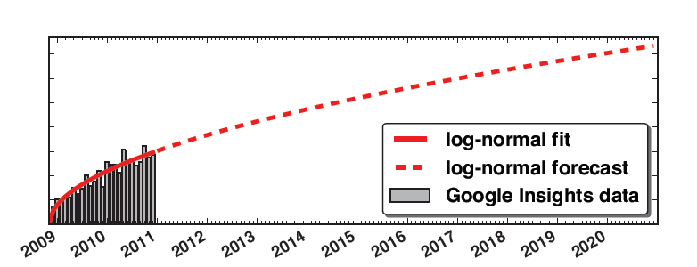
Traditional compartment models might be good but lack flexibility.
Log-normal distributions are more practical.
Thus, concluding by saying memes might be viral but only on social media platforms and not the rest of the internet.

Slide 7
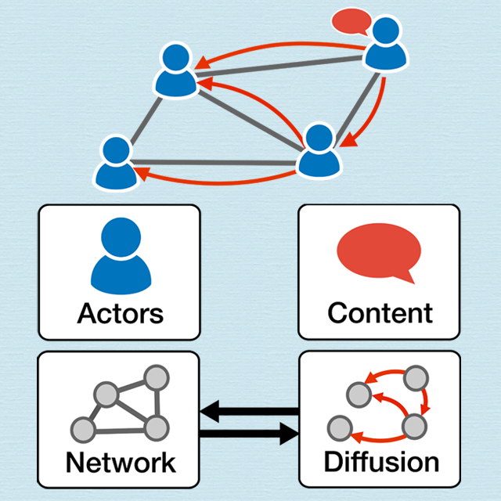
“Predicting the Content Diffusion Path in Online Social Networks”

Slide 8
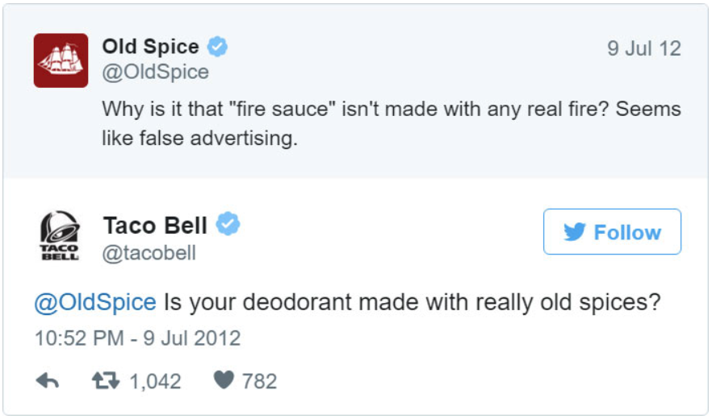
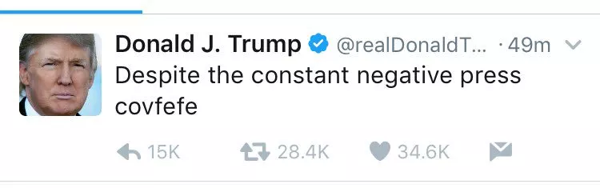
“Marketing with Twitter:
Challenges and Opportunities”
255 million monthly active users
Specific features may have more overall effect in the final decision of a user response
Holds attention + memorable
Upvotes, Author, Dates

Slide 9
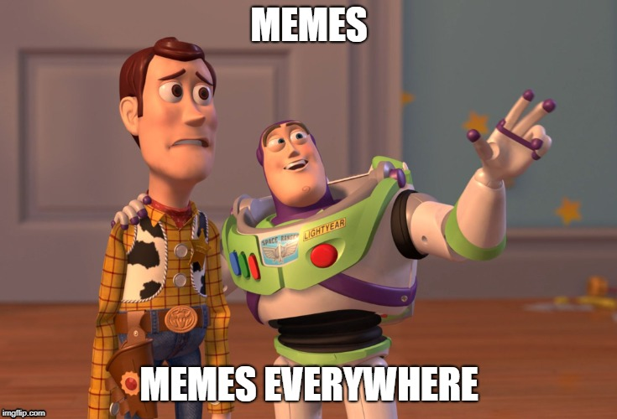
“A Study of Meme Propagation”
Memes gain momentum and then lose their popularity over time
Categorized the Memes, i.e. Political memes vs General Memes

Slide 10
“Going Deeper with Convolutions”
Google’s own research paper proposing the Deep Convolutional Inception Neural Net
By C. Szegedy & 8 others from Google Inc, University of North Carolina
Published to Cornell’s ArXiv on the 17th of September 2014
ImageNet Large-Scale Visual Recognition Challenge 2014 1st Place Winner for Classification and Detection.

Slide 11
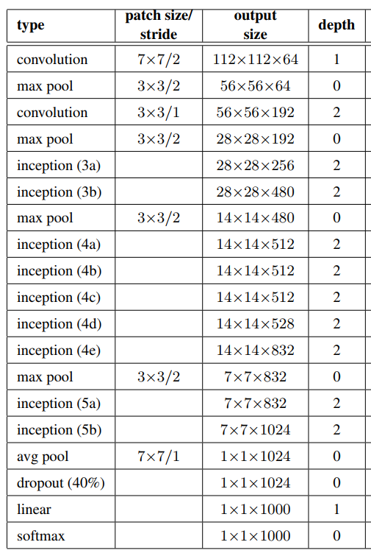
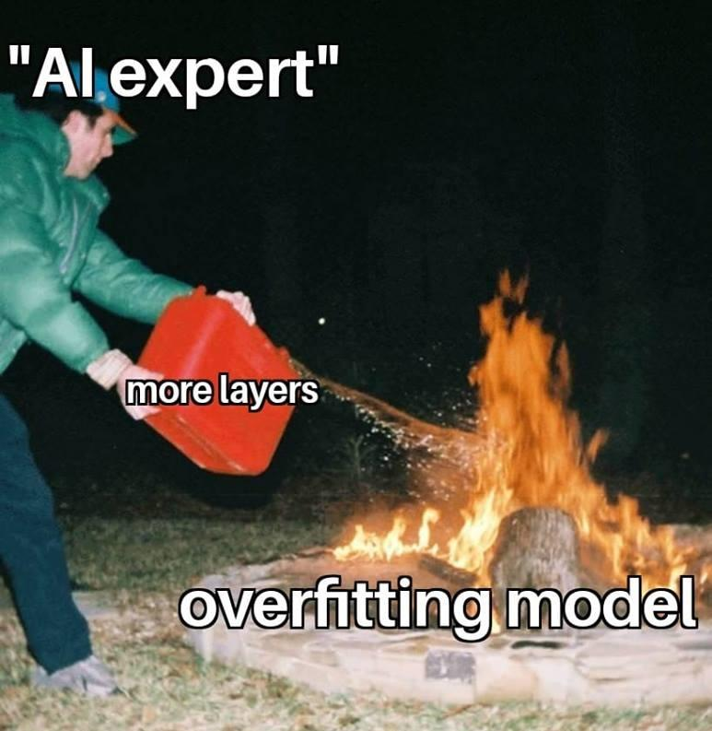
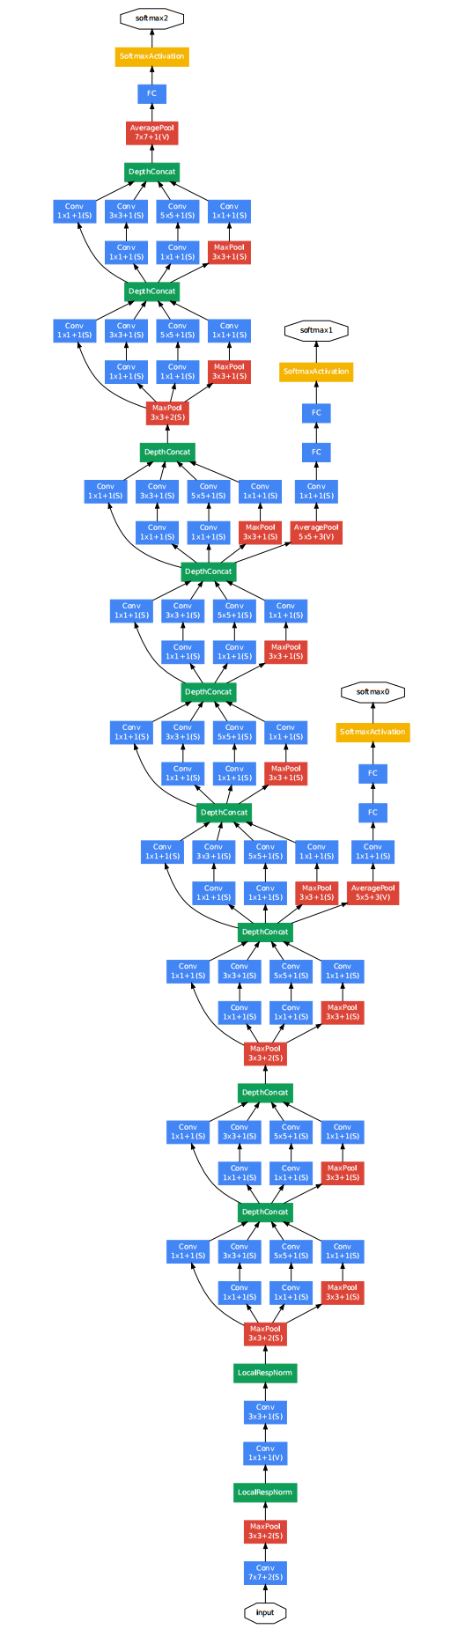
Calculating Confusing Convolutions
112 x 112 = 12,544 !!!!
112 x 112 x 64 = 112² x 8² = 896 x 896 👍

Slide 12
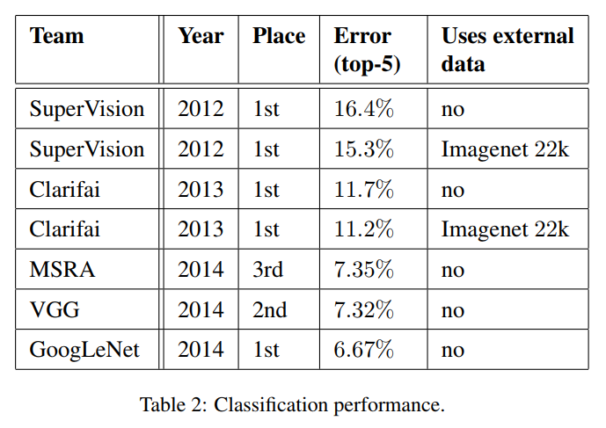
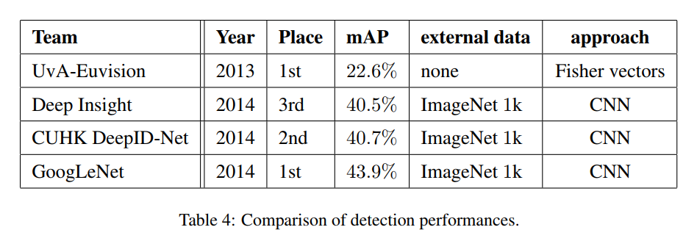
Stats and Scores

Slide 13
“Visualizing Data using TSNE”
T-Distributed Stochastic Neighbor Embedding
Published by Laurens van der Maaten of Tilburg University and Geoffrey Hinton of University of Toronto
First published to The Journal of Machine Learning Research on the 9th of November 2008

Slide 14
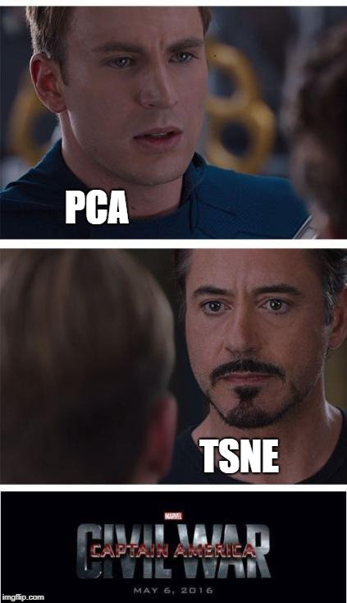
Dimension Warping
TSNE is a Dimensionality Reduction technique
TSNE Projection can map and cluster High Dimensional Data to a 2D or 3D Space by representing noticeable features as vectors
Similar to PCA (Principal Component Analysis)

Slide 15
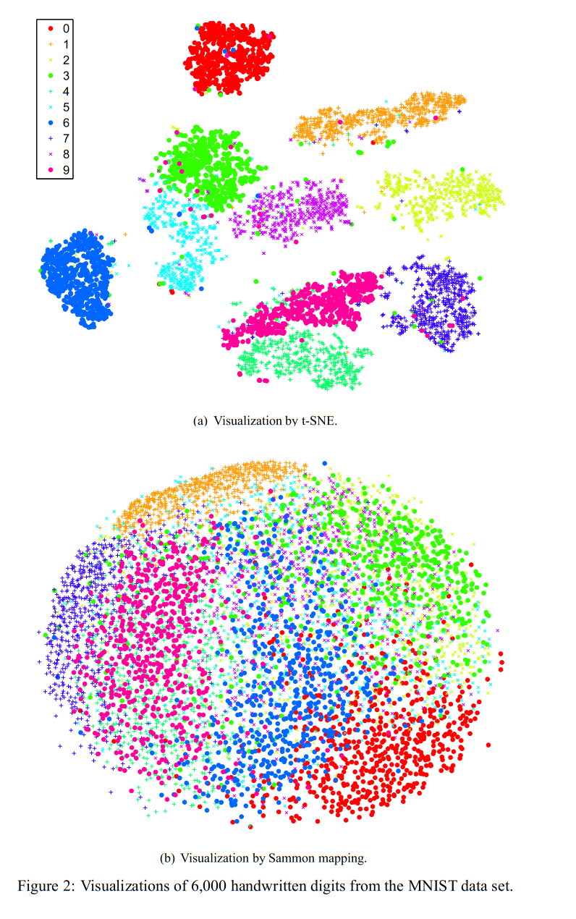
Easily Separable Classifications
Optimized for learning and preserving non-linear patterns in HD datasets
Focuses on local structure rather than original global structure

Slide 16
“UMAP for Dimension Reduction”
Uniform Manifold Approximation & Projection
Published by Leland McInnes and John Healy from Tutte Institute for Mathematics and Computing, Canada
Is a fairly recent technique, 13th February 2018, that is rivaling the otherwise state-of-the-art TSNE.

Slide 17
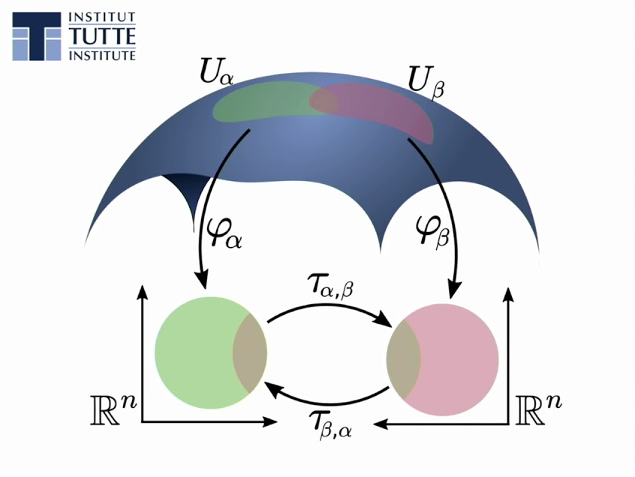
UMAP Ur Own Clusters
Isn’t actually about maps. Shocker I know...
Processes neighbors in HD space.
Connects clusters with other clusters with fancy topological math and neighbor graphs.
This forms a manifold with no distortion making it uniform

Slide 18
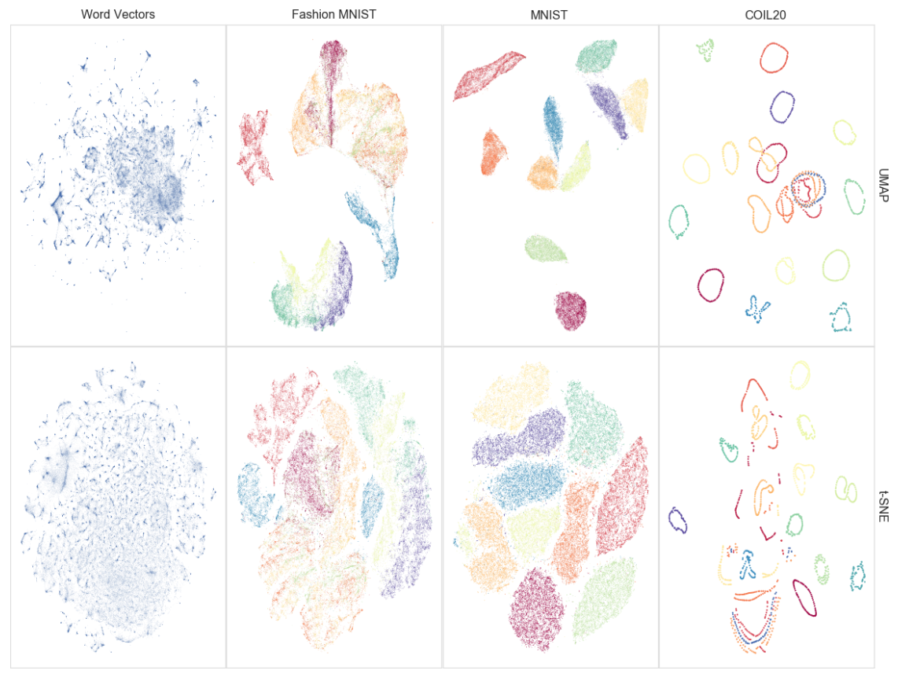

Slide 19
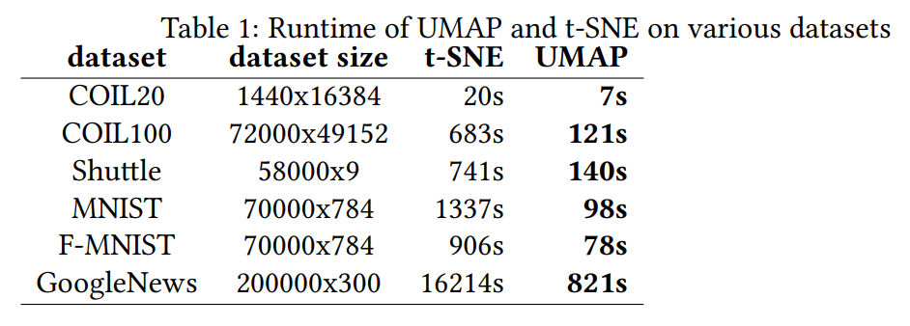
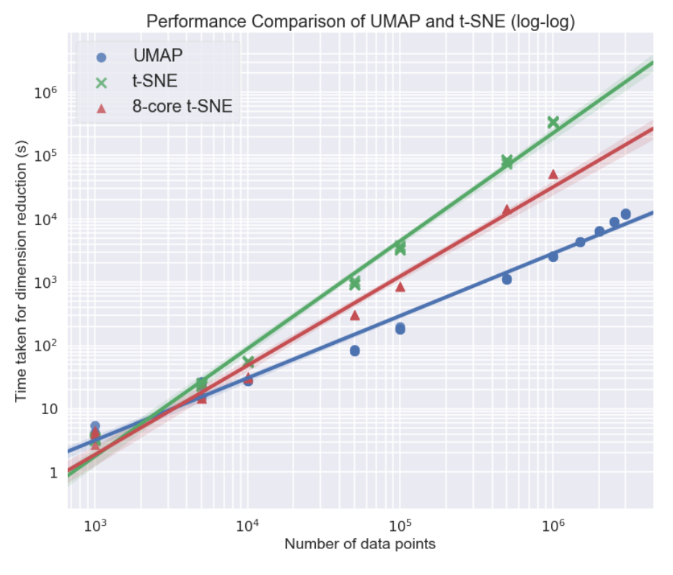

Slide 20

Back to
Meme Review
What have WE done so far?

Slide 21

Data Source & Preprocessing Recap
Kaggle
Reddit meme dump
JSON metadata
Image Preprocessing
Resize Resolution
Convert All images to JPG
Process JSON metadata
Messy JSON Organization
UNIX-based UTC Timestamp

Slide 22

Neural Networks Recap
Inception
Used before the TSNE Cluster to produce classifiable feature vectors
AlexNet
VGGnet

Slide 23






Data Visualization

Slide 24
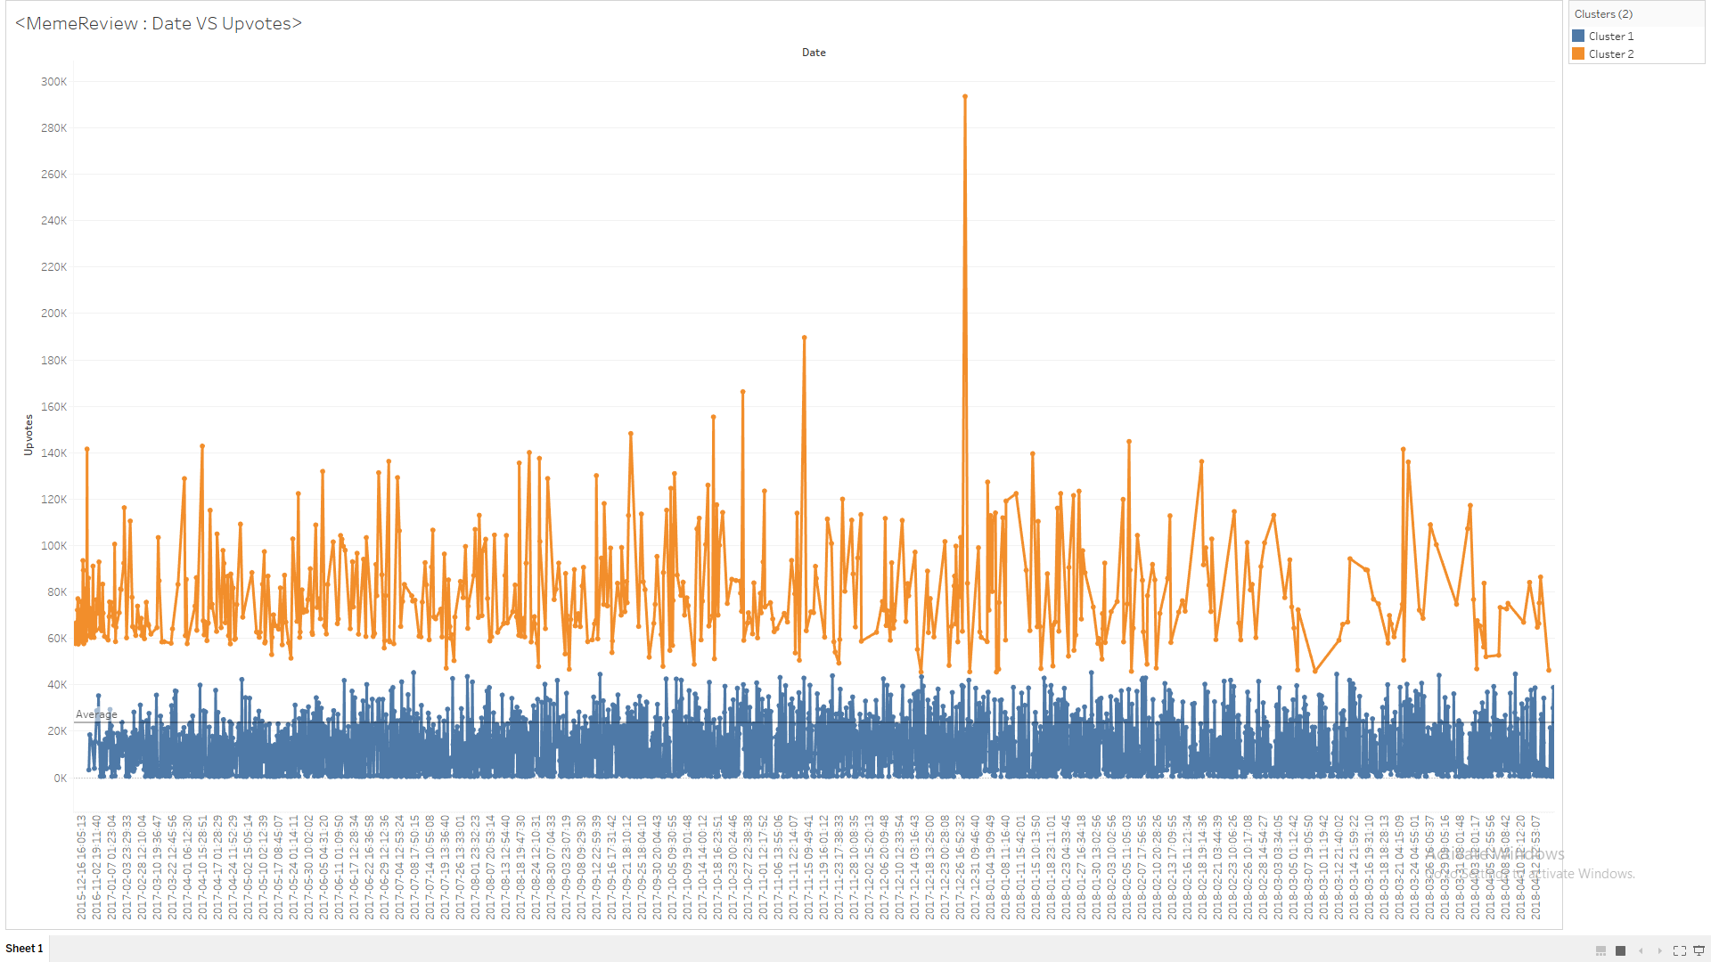
Data Visualization of Correlations
Graph: Date vs Upvotes

Slide 25
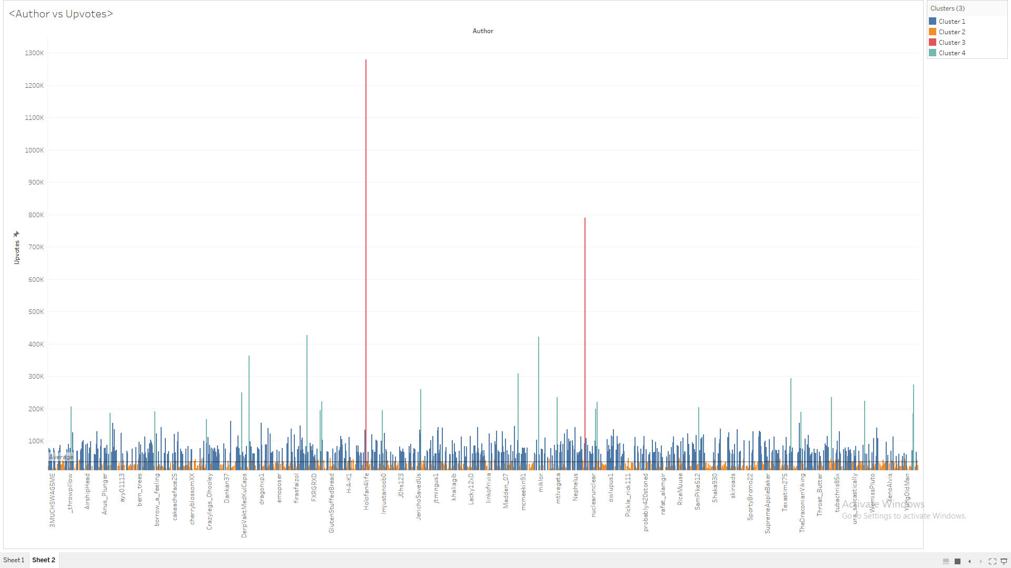
Data Visualization of Correlations
Graph: Author vs Upvotes

Slide 26
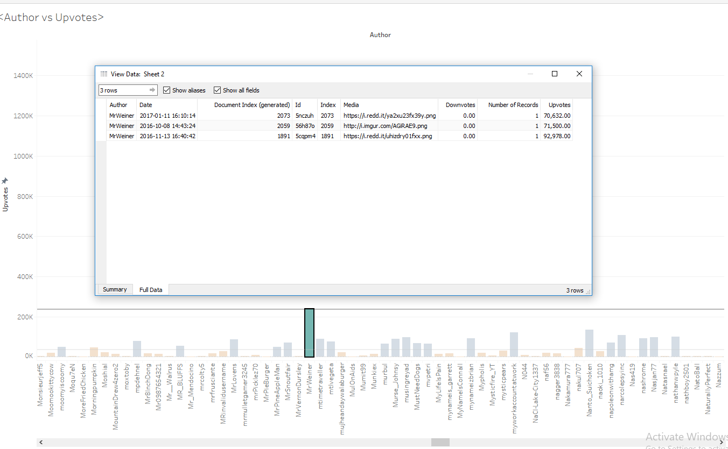

Slide 27
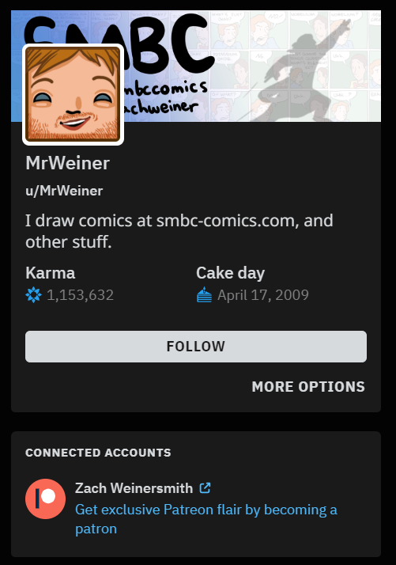
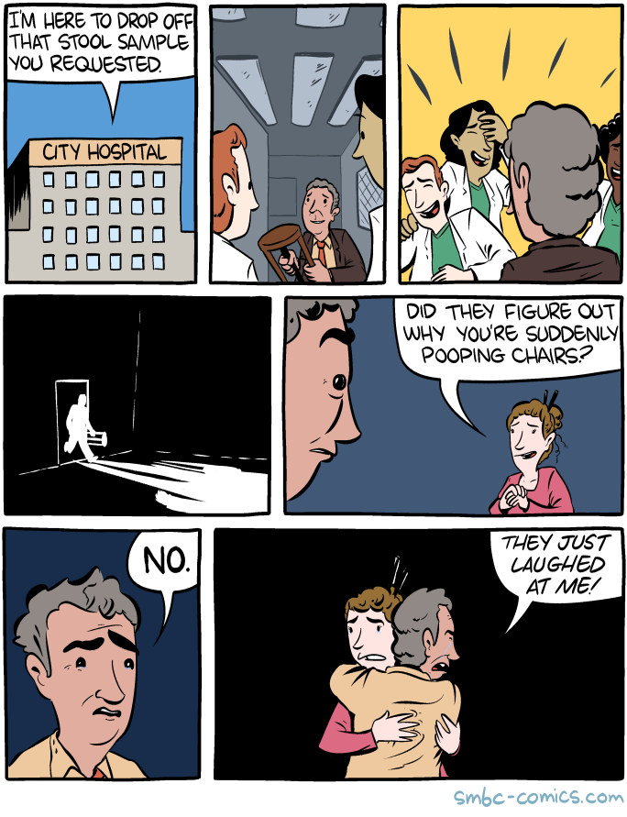
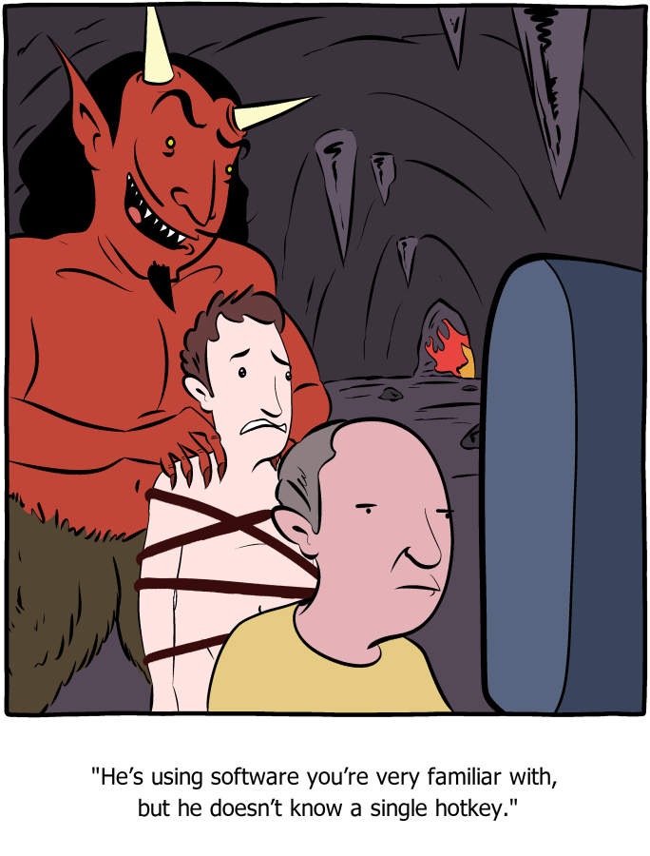
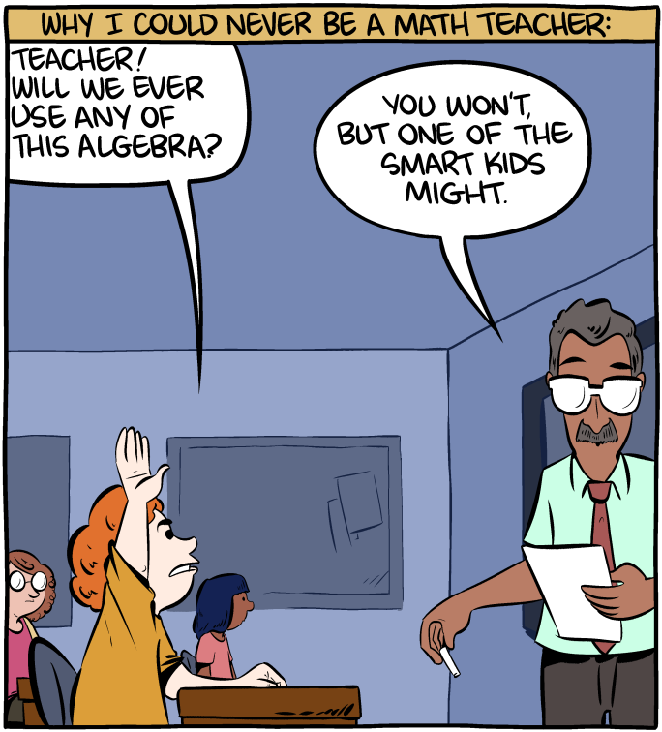

Slide 28
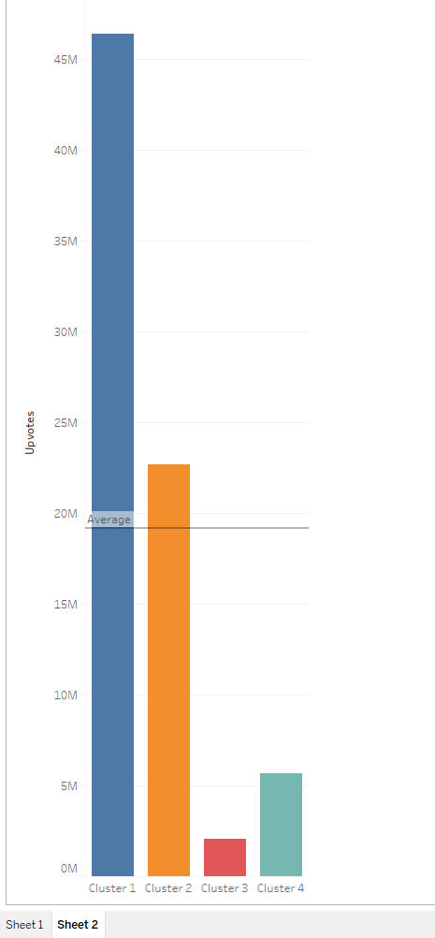
Author Clusters
4 Types
of
“Meme-creators”

Slide 29

See in Numbers
Produce image vectors from Inception Neural Net penultimate pool layer’s weights using TensorFlow
Use previous Vectors for Clustering with UMAP then project onto an HTML Canvas running D3.js

Slide 30
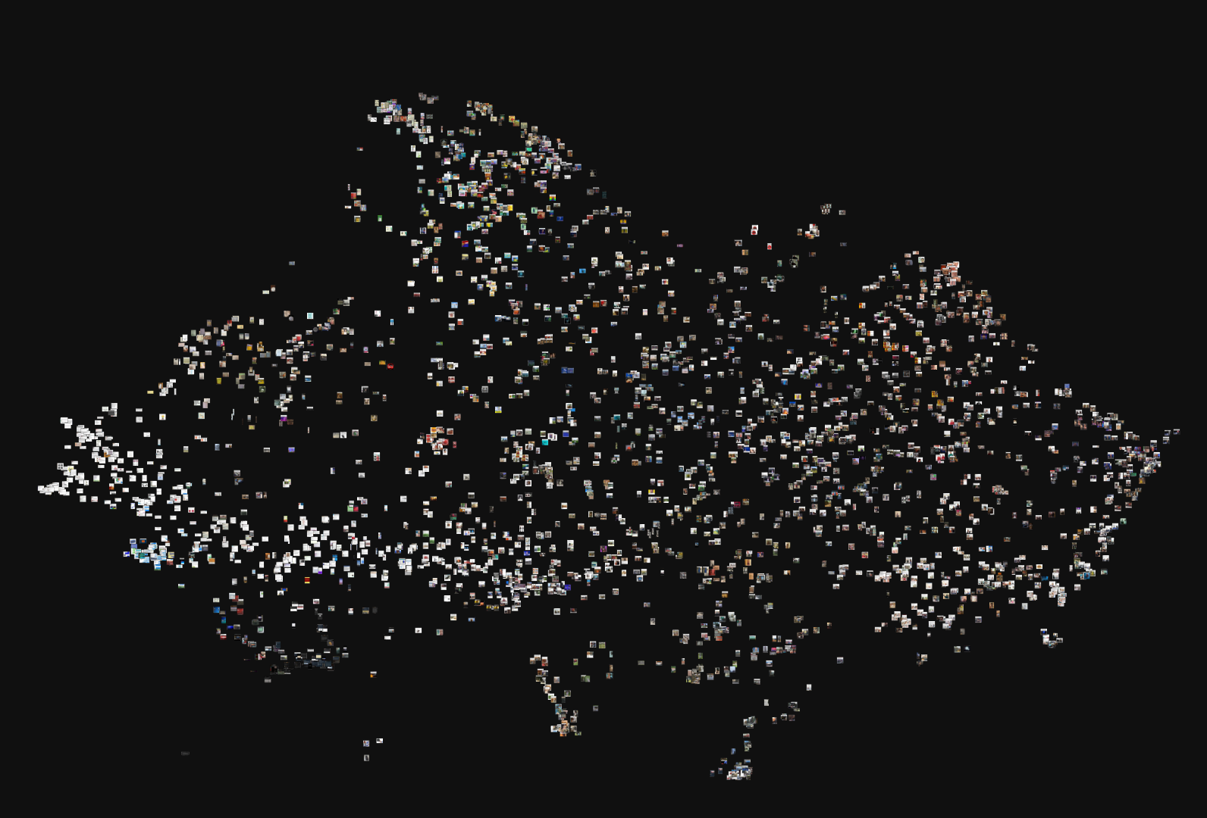
A UMAP Map of Memes
Population 3,326

Slide 31
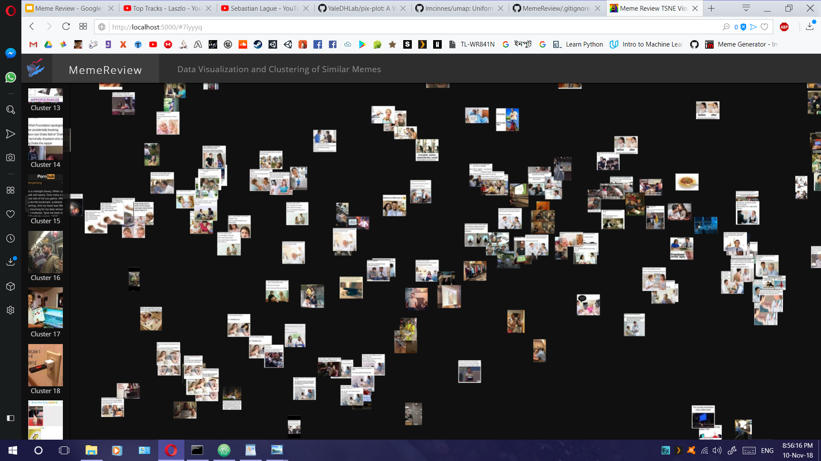
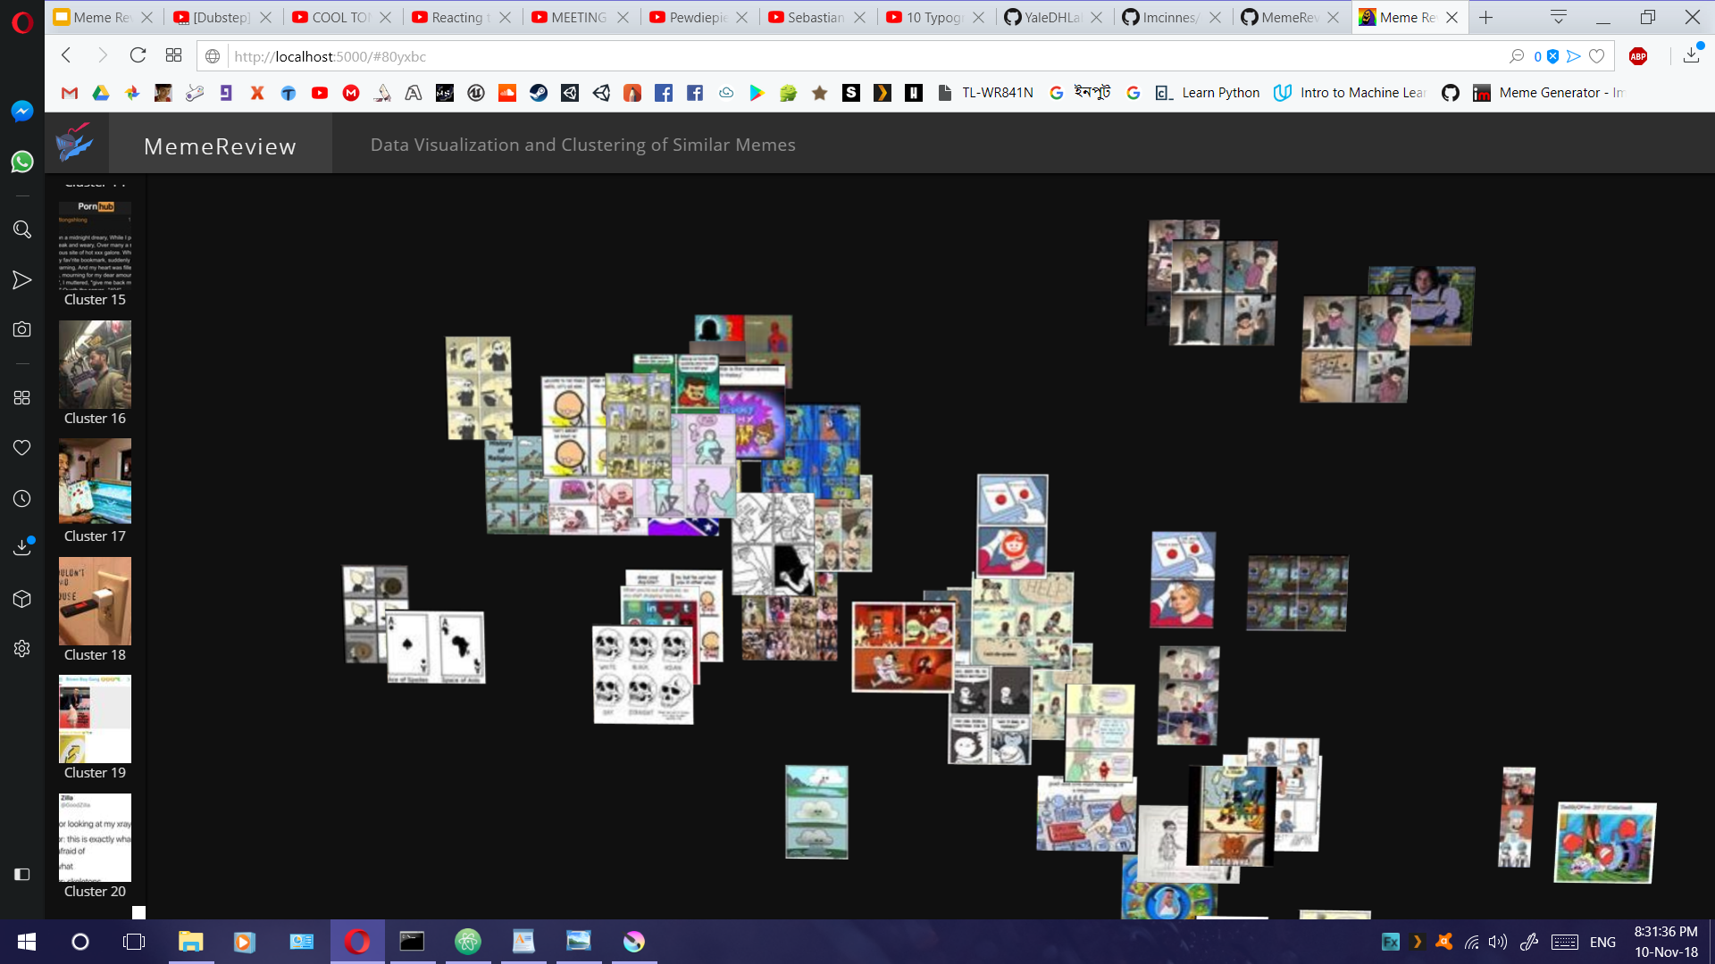
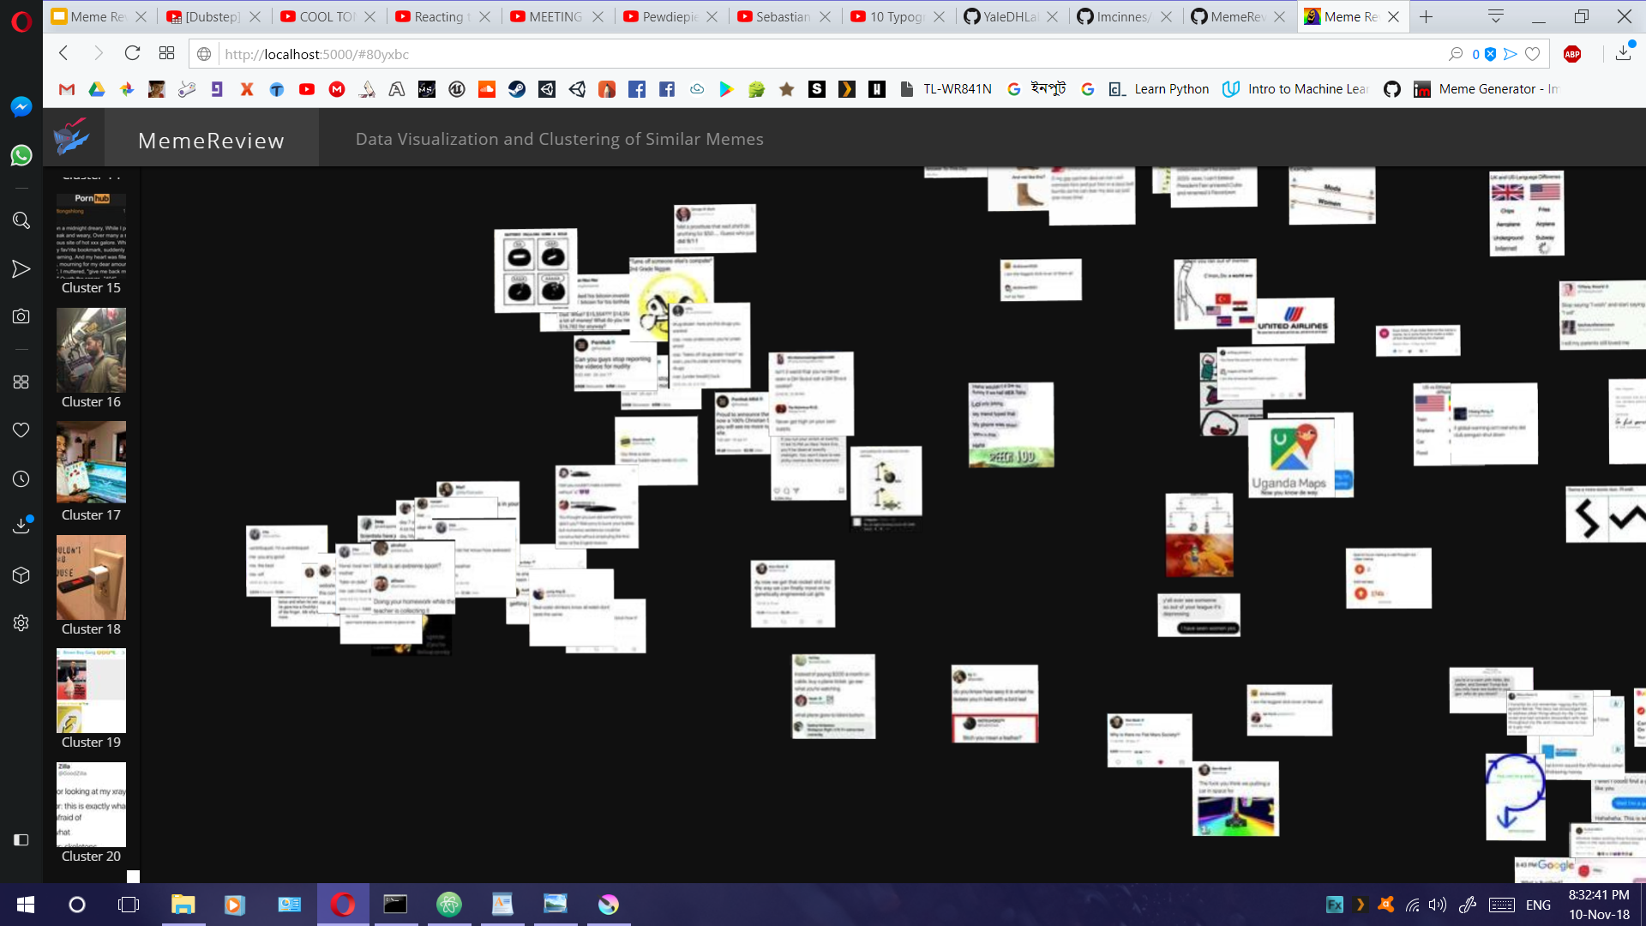
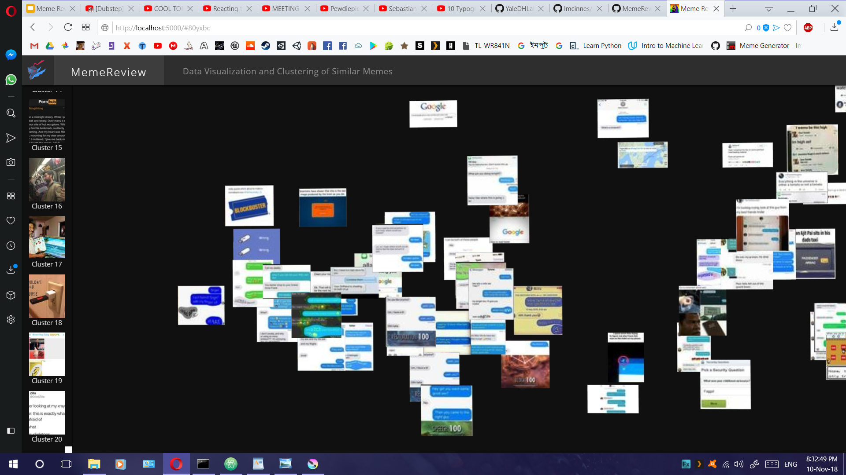
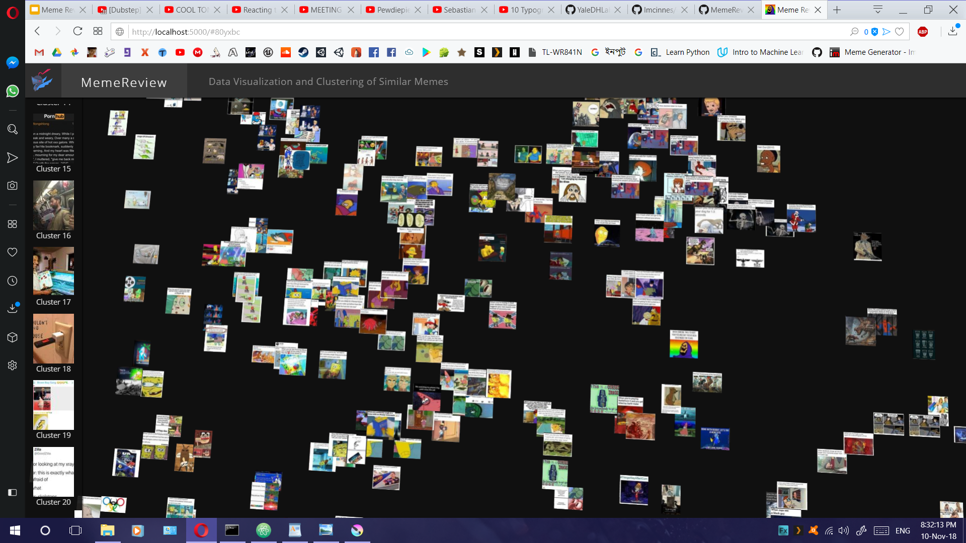
Clusters of Memes

Slide 32

TSNE

Slide 33
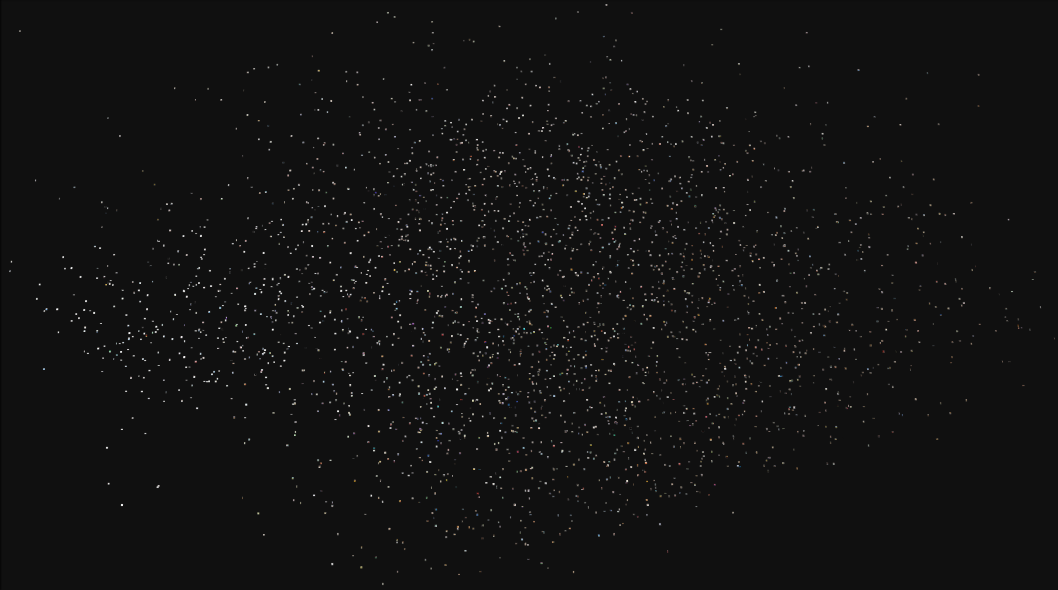
PCA

Slide 34
UMAP

Slide 35
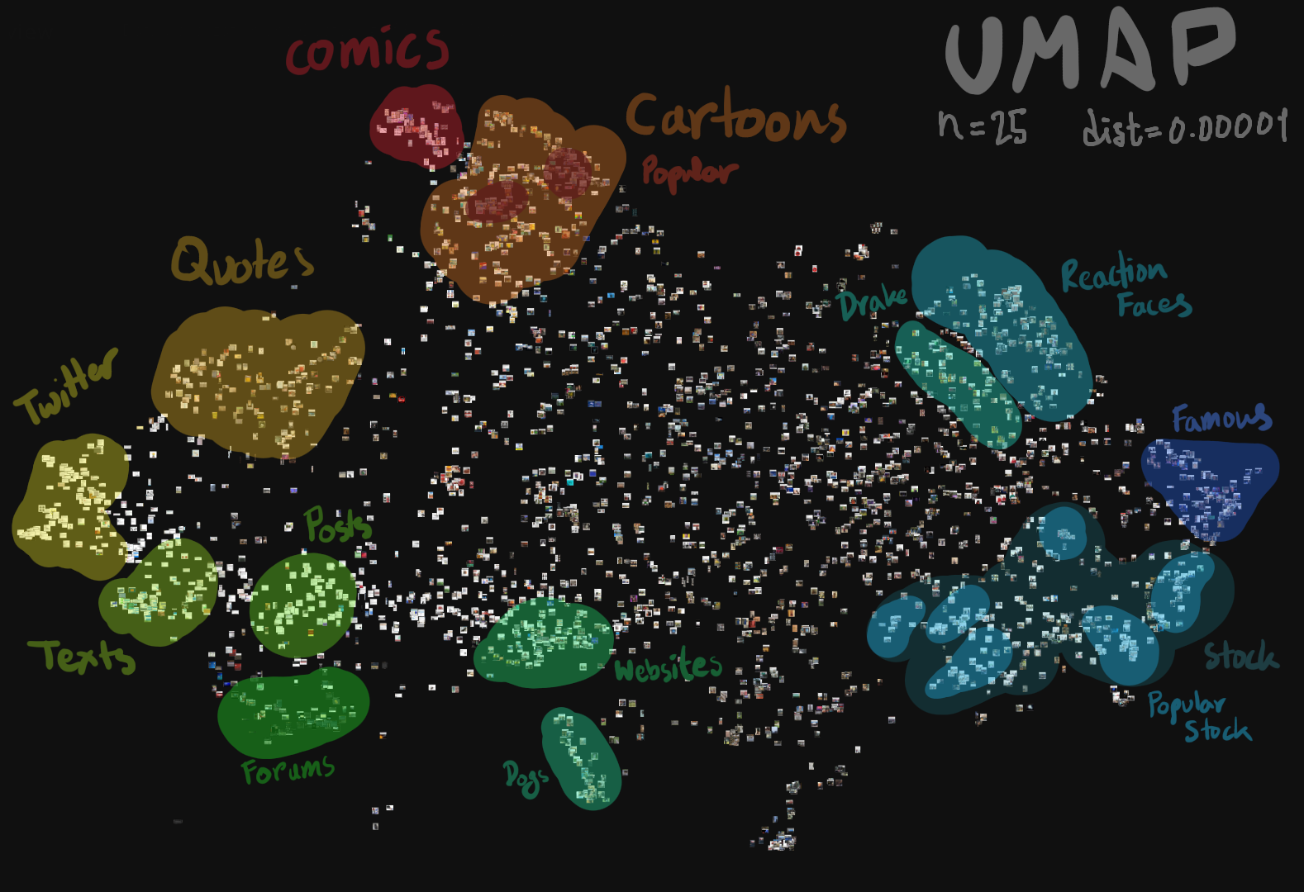
UMAP Labelled

Slide 36
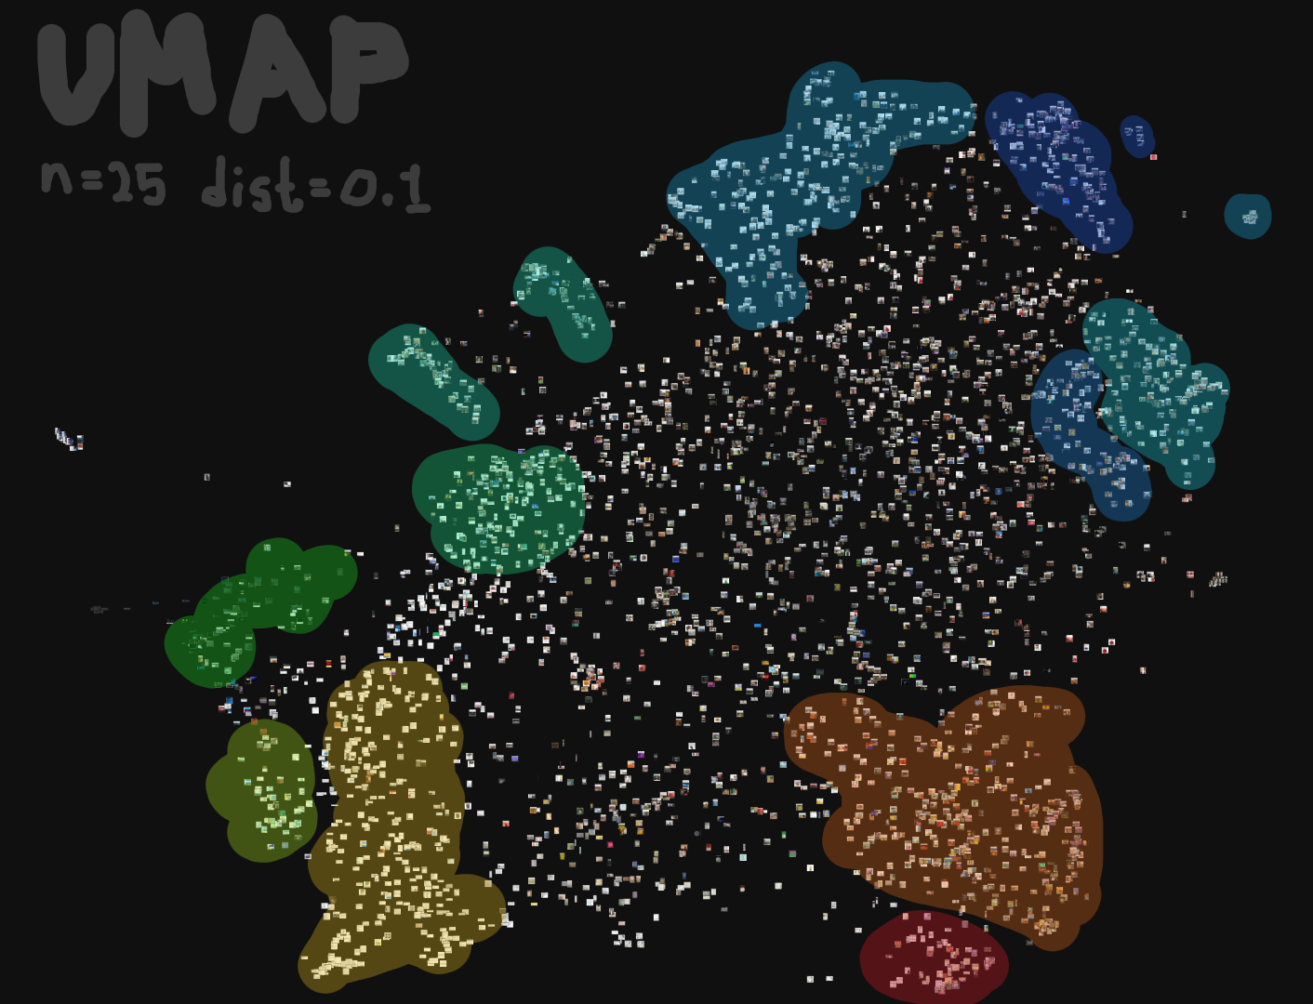
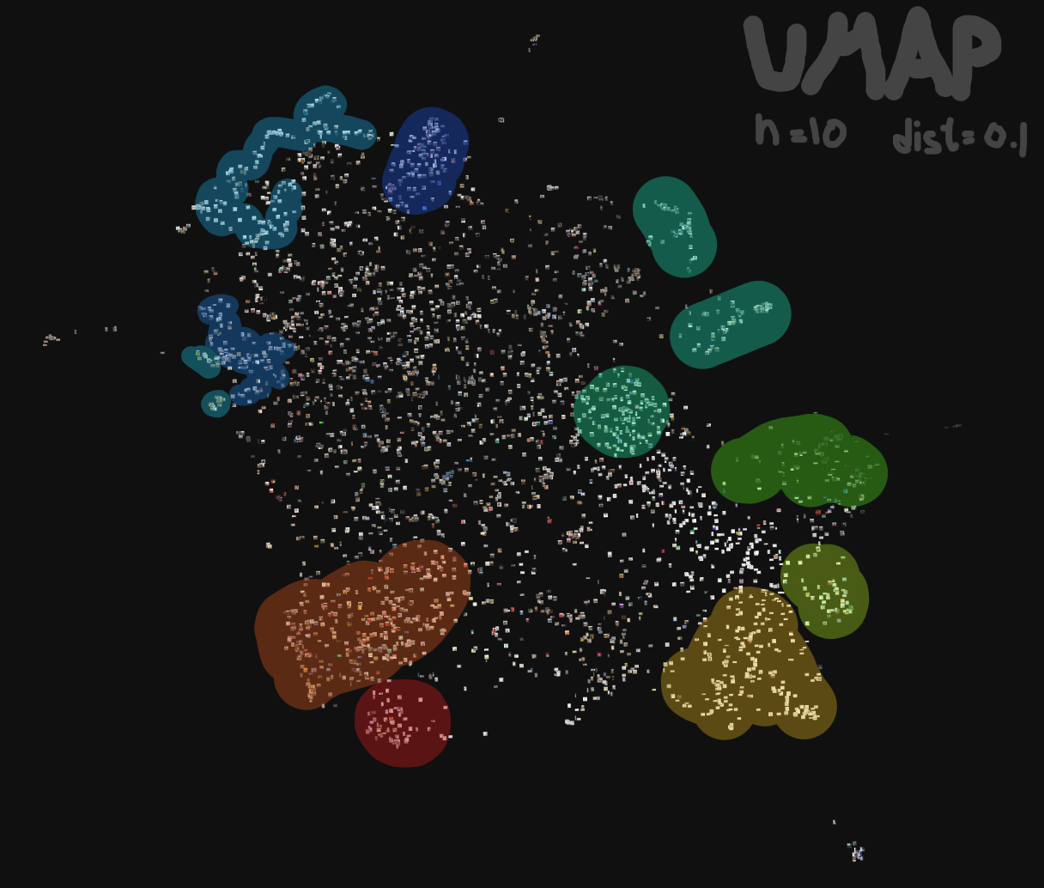
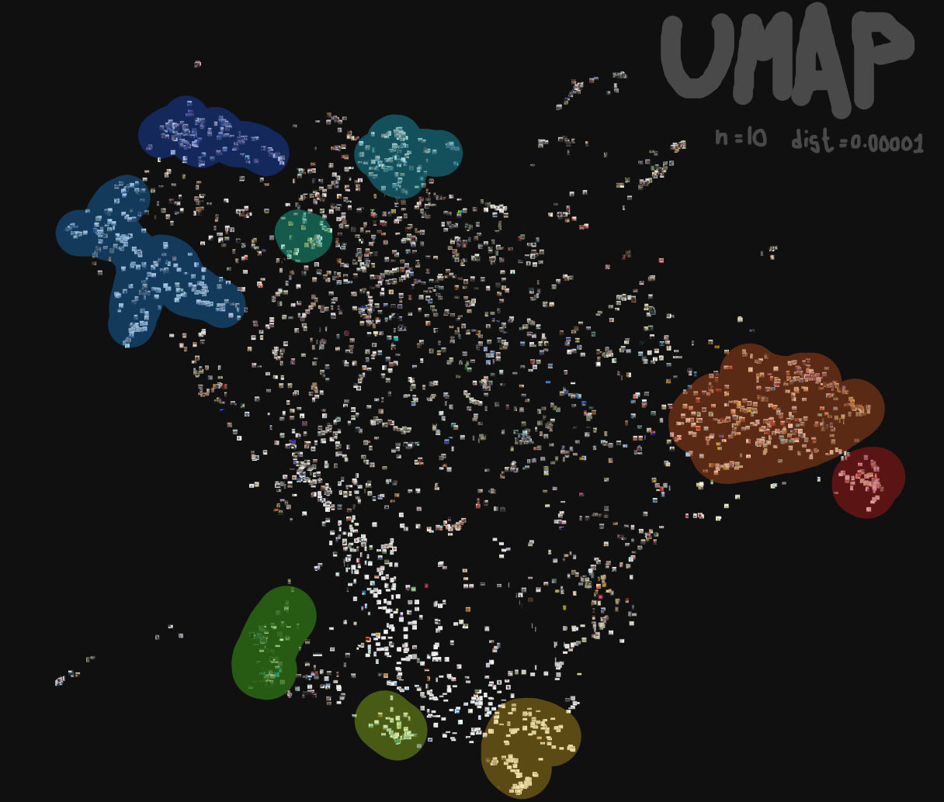
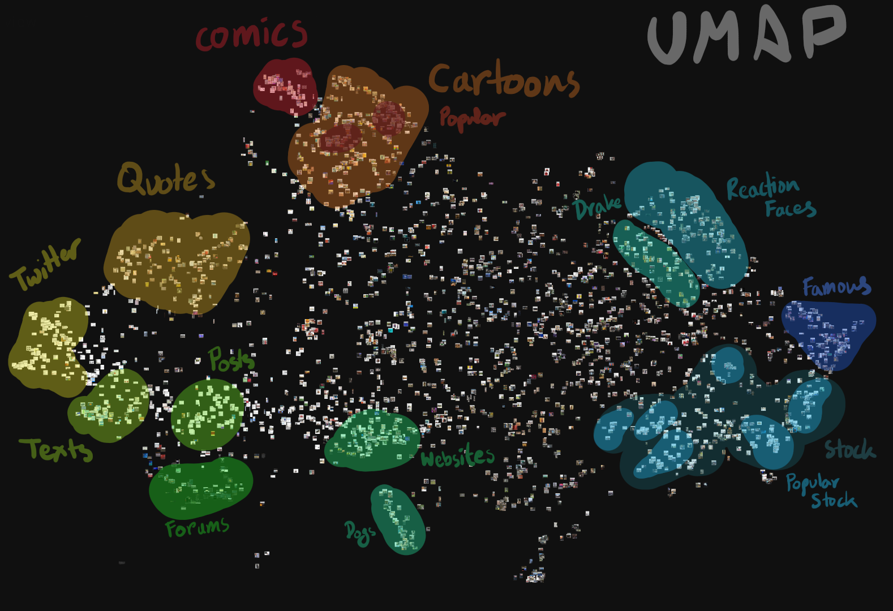
n=25
dist=0.1
n=10
dist=0.1
n=10
dist=0.00001
n=25, dist=0.00001

Slide 37
Contributors
Abir Rahman
Marketing with Twitter
A Study of Meme Propagation
Jawad Aziz Khan
Going Deeper with Convolutions
Visualizing Data with TSNE
UMAP for Dimension Reduction
Taufiq Rahman
Insights into Internet Memes
Predicting the Content Diffusion Path in Online Social Networks

Slide 38


Any Questions?

Slide 39
